Slide 1
AI Project:
Searching for the closest restaurant of a specific cuisine within the chosen area
Group 5
Gerda Ugne Pupelyte 190013631
Laura Naslenaite 190013642
Rael Watt 190011819
Sem Jasaitytė 190014736 Matthew Bain 190012264

Slide 2
Contents
Title
Contents slide
The problem definition
The importance of the problem
The data used
Data visualization
Proposed search strategies
Depth-limited search results
Uniform-cost search results
Greedy best-first search results
Interface to manipulate the data
Further expansions
Conclusion of the results

Slide 3
The Problem
The problem is to determine the closest restaurant with a preferred cuisine in the chosen location.
States: The state is determined by the cuisine the restaurant provides, its name, unique ID and location, specified by longitude and latitude. There are n restaurants, each with x cuisines, where x > 0. The location is processed using a coordinate system.
Initial State: The agent starts in the restaurant Hauz Khas Social. The provided cuisines are Continental, American, Asian, North Indian; unique ID is 308322, and the location: 28.5542851 (Longitude), 77.1944706 (Latitude).
Actions:
Scan nearby area: The eligibility for travelling to a restaurant is determined by the agent’s location. By using a coordinate system, the map of restaurants is examined, and restaurants within the range of the agent for a set distance are shown as available paths to travel to.
Restaurant inspection: The agent can inspect a restaurant’s cuisine within a set distance (150KM) from their current location by travelling to the chosen restaurant. After the travel, the agent’s location is updated to match the visited restaurant’s location.
Transition model: the state is changed by the agent going from the current restaurant(i.e. node) to another one that is in the searching distance, and inspecting its cuisine. The state is then updated with the latter restaurant’s state. The agent can then continue travelling to another restaurant if the goal is not met.
Goal test: Checks whether the current restaurant’s cuisine matches the preferred cuisine of the Agent (Mexican).
Path cost: Each step costs the distance between the restaurants, so the path cost is the distance between the starting location and the final restaurant.

Slide 4
Relevance of the problem
The problem offers an efficient way to find a close restaurant with preferable cuisine. This is based on your original location, saving time by not having to explore every single option there is. An optimal solution is provided by saving the agent’s time - considering the path cost (distance) to the destination.

Slide 5
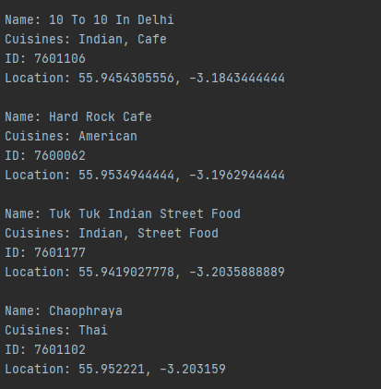
The data used
The data used for the project was Zomato Restaurants data by Metha S., retrieved in a format of JSON. [1] We chose to only use the first extract of it, containing 76 restaurants in total.
The data about the restaurants was filtered and extracted as follows:
Name of the restaurant
Cuisines provided
Unique ID
Location of the restaurant, identified by:
Latitude
Longitude
[1] Metha, S. 2019. Zomato Restaurants Data. [Accessed on 9 March 2021] [Online]. Available from: https://www.kaggle.com/shrutimehta/zomato-restaurants-data
An example of the extracted data.

Slide 6
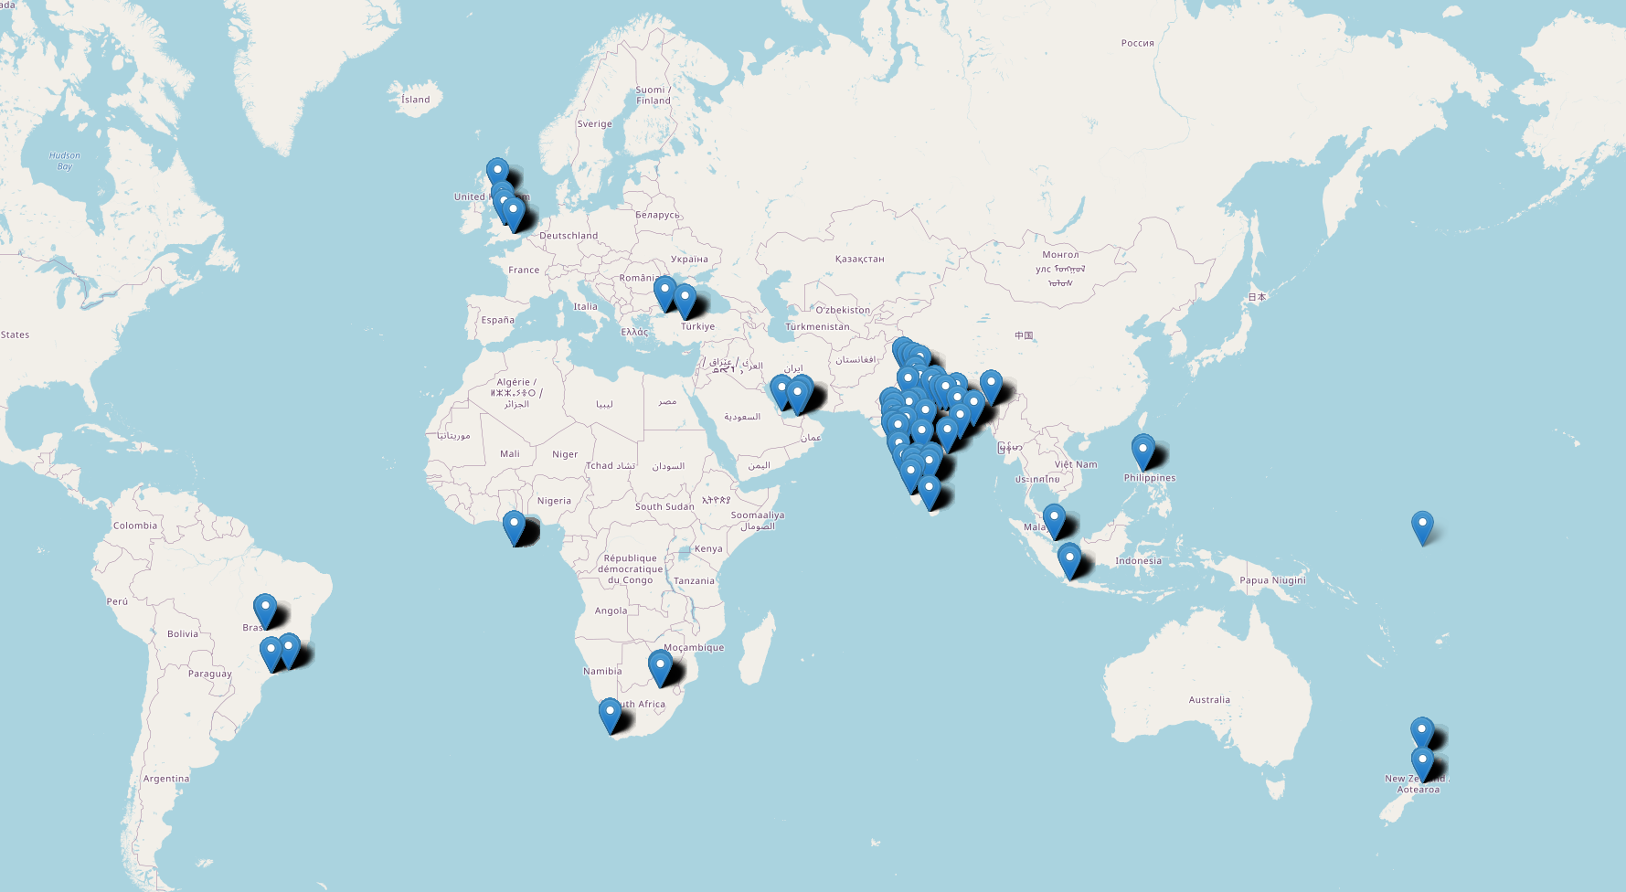
The location data visualized
Achieved by using Folium library [2].
[2] - Rob, S. 2013. Folium. [ Accessed on 22 March 2021] [Online]. Available from: https://python-visualization.github.io/folium/

Slide 7
Proposed search strategies
We have tested the problem with the following search strategies:
Depth-limited search
Uniform-cost search
Best-First(Greedy) search
A* search (not covered in the presentation)
The searches were carried out by using AIMA3 libraries in Python 3.7 [3].
Extracted and adapted JSON data from the database.
For the heuristic function, we calculated the Euclidean distance.
The average branching factor was calculated by using the scan function in order to get the number of children each node has, and then dividing it by the number of non-leaf nodes.
[3] - Multiple contributors. 2020. Python code for the book Artificial Intelligence: A Modern Approach. [Accessed on 11 March 2021] [Online]. Available from: https://github.com/aimacode/aima-python

Slide 8
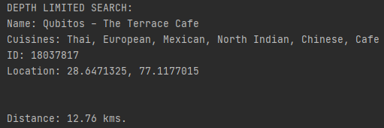
Depth-limited search results
The depth-limited search results in a goal state within the restaurant called Qubitos - The Terrace Cafe. The depth-limited search was carried out in 5 depth levels.
The path cost for this searching algorithm was 12.76 kilometres, and the running time was 12.9 milliseconds.
Depth-limited search is incomplete. In this case, a solution was found. However, it is non-optimal, as there could be closer restaurants with the same goal state.
Complexity analysis
Maximum depth (L) is 5, and the average branching factor (B) is 21
Time complexity: O(B^L), O(21^5)
Space complexity: O(BL), O(21*5), O(105)
Time complexity is a bigger issue compared to the space complexity.

Slide 9
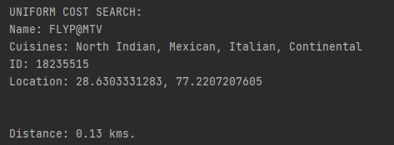
Uniform-cost search results
The uniform cost search results in reaching goal state in the restaurant FLYP@MTV. In comparison to depth-limited search, it is clear that this search is more efficient in terms of the path cost (from 12.76kms to 0.13kms), with a slightly shorter running time of 11.9 milliseconds.
Uniform-cost search is complete and optimal. Frontier is stored as priority queue ordered by lowest path cost. We can see how the optimality holds compared to depth-limited search.
Complexity analysis
Average branching factor: 21
Time complexity: Worst case - O(B^[1+C*/e] ), where B is the branching factor, C* is the cost of optimal solution, and e is the action cost. If all step costs are equal, it’s O(B^d+1).
Space complexity: Same as Time Complexity.

Slide 10
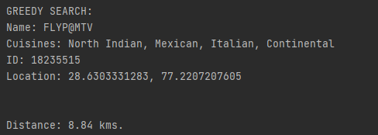
Greedy Best-First search results
The greedy best-first search reaches the goal state in the same result as Uniform-cost search, FLYP@MTV. However, the path cost has increased drastically from 0.13 kilometres to 8.84 kilometres, though the running time of 5.9 milliseconds is shorter by around half.
Greedy best-first search is incomplete; however, in this scenario it did find a goal node. It is non-optimal, and this is obvious when we compared the results to uniform-cost search. However, the results are still better than using depth-limited search.
Complexity analysis
Average branching factor: 21
Time complexity: O(B^M), where M is the maximum depth; O(21^M)
Space complexity: Same as Time Complexity.

Slide 11
Conclusion of results
The search algorithms listed by path cost:
Uniform-cost search 0.13 km, A* search 0.13 km
Greedy best-first search 8.84 km
Depth-limited search 12.76 km
Ordered by running time:
Greedy best-first 5.9ms
A* search 10.9ms
Uniform-cost search 11.9 ms
Depth-limited search 12.9 ms
Each algorithm dominates different areas of the solution.
A* search would be most optimal for finding the closest restaurant, without much trade-off for time and space complexity.

Slide 12

Interface to manipulate the data

Slide 13
Further enhancements
Expanding the application of traditional search algorithms
Since the problem could have multiple goals, to ensure the optimality and completeness of the search algorithms, the stopping condition could be improved by considering not only reaching a goal state (if it is found) but also identifying several goal states within the limited area of the search.
Application of machine learning
Not only could some advanced machine learning approaches ensure optimality and completeness but also they could be utilized to solve the problem in a more efficient way time and space-wise:
Reinforcement learning, specifically Q-learning which is based on assigning reward values to goal states and non-goal states over multiple repetitions of actions. With each repetition an agent is gaining more and more knowledge about the states (i.e. their reward values) where at the end , the trained agent is able to find the fastest way to the goal within the minimum time.

Slide 14
Thank you for watching!
Any questions?

